Slide 1
Inverse of a Matrix
Hung-yi Lee
Notes:
Textbook: Chapter 2.3, 2.4
Outline:
Inverse
Invertibility
elementary row operation
in generatl

Slide 2
Inverse of a Matrix
What is the inverse of a matrix?
Elementary matrix
What kinds of matrices are invertible
Find the inverse of a general invertible matrix

Slide 3
Inverse of a Matrix
What is the inverse
of a matrix?
Notes:
Outline:
Inverse
Invertibility
elementary row operation
in generatl

Slide 4









Inverse of Function
Two function f and g are inverse of each other (f=g⁻¹, g=f⁻¹) if ……
For $any v$
g
f
$$y=g\left(x\right)$$
$$x=f\left(v\right)$$
$$v$$
$$y=v$$
f
g
$$y=f\left(x\right)$$
$$x=g\left(v\right)$$
$$v$$
$$y=v$$
Notes:
Inverse of a function is unique

Slide 5



Inverse of Matrix
If B is an inverse of A, then A is an inverse of B, i.e., A and B are inverses to each other.
$$AB=I$$
For $any v$
A
B
$$y=g\left(x\right)$$
$$x=f\left(v\right)$$
$$v$$
$$y=v$$
B
A
$$y=f\left(x\right)$$
$$x=g\left(v\right)$$
$$v$$
$$y=v$$
$$BA=I$$
Notes:
Inverse of a function is unique
Compose is matrix multiplication

Slide 6




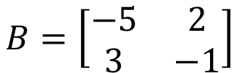


Inverse of Matrix
If B is an inverse of A, then A is an inverse of B, i.e., A and B are inverses to each other.
A is called invertible if there is a matrix B such that $AB=I$ and $BA=I$
B is an inverse of A
$$B=A^{−1}$$
$$A^{−1}=B$$
$$AB=\left[\begin{matrix}1 & 0 \\ 0 & 1\end{matrix}\right]$$
$$A=\left[\begin{matrix}1 & 2 \\ 3 & 5\end{matrix}\right]$$
$$B=\left[\begin{matrix}−5 & 2 \\ 3 & −1\end{matrix}\right]$$
$$BA=\left[\begin{matrix}1 & 0 \\ 0 & 1\end{matrix}\right]$$
Notes:
No nxn
Inverse of a function is unique
Compose is matrix multiplication

Slide 7
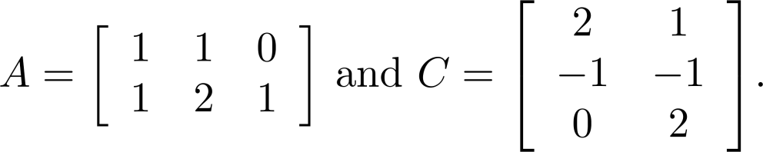

Inverse of Matrix
If B is an inverse of A, then A is an inverse of B, i.e., A and B are inverses to each other.
A is called invertible if there is an matrix B such that $AB=I$ and $BA=I$
n x n?
B is an inverse of A
$$B=A^{−1}$$
$$A^{−1}=B$$
Non-square matrix cannot be invertible
Notes:
No nxn
Inverse of a function is unique
Compose is matrix multiplication

Slide 8









Inverse of Matrix
Not all the square matrix is invertible
Unique
$$AB=I$$
$$BA=I$$
$$AC=I$$
$$CA=I$$
$$B=BI$$
$$=B\left(AC\right)$$
$$=\left(BA\right)C$$
$$=IC$$
$$=C$$

Slide 9

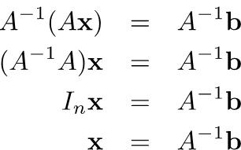
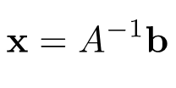
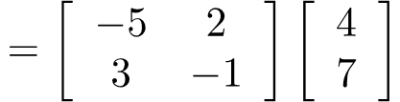
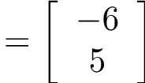

Solving Linear Equations
The inverse can be used to solve system of linear equations.
If A is invertible.
$$Ax=b$$
However, this method is computationally inefficient.

Slide 10




Input-output Model
假設世界上只有食物、黃金、木材三種資源
 | 需要食物 | 需要黃金 | 需要木材˙
生產一單位食物 | 0.1 | 0.2 | 0.3
生產一單位黃金 | 0.2 | 0.4 | 0.1
生產一單位木材 | 0.1 | 0.2 | 0.1
Cx
C
x
$$\left[\begin{matrix}0.1x_{1}+0.2x_{2}+0.1x_{3} \\ 0.2x_{1}+0.4x_{2}+0.2x_{3} \\ 0.3x_{1}+0.1x_{2}+0.1x_{3}\end{matrix}\right]$$
$$\left[\begin{matrix}0.1 & 0.2 & 0.1 \\ 0.2 & 0.4 & 0.2 \\ 0.3 & 0.1 & 0.1\end{matrix}\right]$$
$$\left[\begin{matrix}x_{1} \\ x_{2} \\ x_{3}\end{matrix}\right]$$
$$=$$
須投入
Consumption matrix
想生產

Slide 11
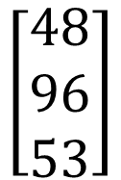
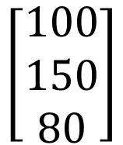
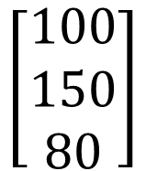

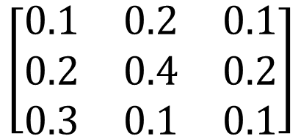
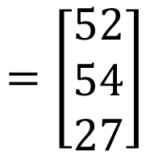
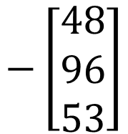

Input-output Model
Cx
C
x
$$\left[\begin{matrix}48 \\ 96 \\ 53\end{matrix}\right]$$
$$\left[\begin{matrix}0.1 & 0.2 & 0.1 \\ 0.2 & 0.4 & 0.2 \\ 0.3 & 0.1 & 0.1\end{matrix}\right]$$
$$\left[\begin{matrix}100 \\ 150 \\ 80\end{matrix}\right]$$
$$=$$
須投入
Consumption matrix
想生產
須考慮成本：
淨收益
$$\left[\begin{matrix}100 \\ 150 \\ 80\end{matrix}\right]$$
$$−\left[\begin{matrix}48 \\ 96 \\ 53\end{matrix}\right]$$
$$=\left[\begin{matrix}52 \\ 54 \\ 27\end{matrix}\right]$$
Demand
Vector d
$$x−Cx=$$

Slide 12
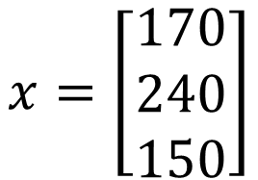

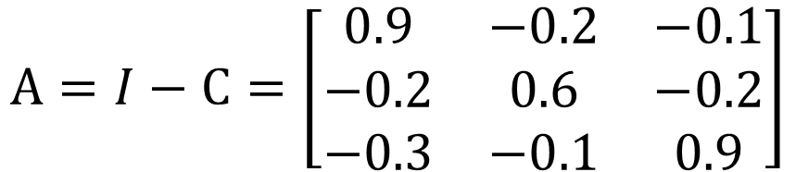

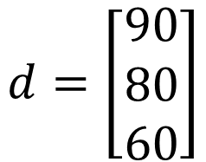
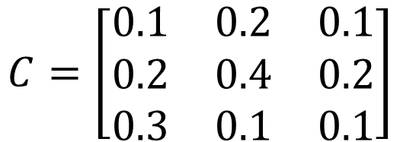

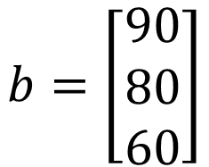
Input-output Model
$$C=\left[\begin{matrix}0.1 & 0.2 & 0.1 \\ 0.2 & 0.4 & 0.2 \\ 0.3 & 0.1 & 0.1\end{matrix}\right]$$
$$d=\left[\begin{matrix}90 \\ 80 \\ 60\end{matrix}\right]$$
Demand
Vector d
生產目標 x 應該訂為多少?
$$A=I−C=\left[\begin{matrix}0.9 & −0.2 & −0.1 \\ −0.2 & 0.6 & −0.2 \\ −0.3 & −0.1 & 0.9\end{matrix}\right]$$
$$x−Cx=d$$
$$Ix−Cx=d$$
$$b=\left[\begin{matrix}90 \\ 80 \\ 60\end{matrix}\right]$$
$$x=\left[\begin{matrix}170 \\ 240 \\ 150\end{matrix}\right]$$
$$\left(I−C\right)x=d$$
Ax=b

Slide 13






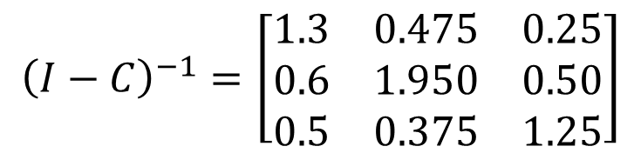

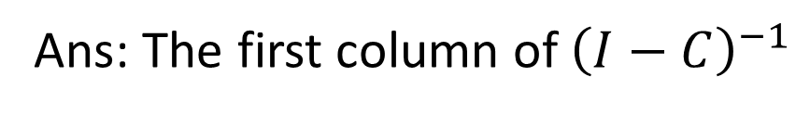
Input-output Model
提升一單位食物的淨產值，需要多生產多少資源？
Ans: The first column of ${\left(I−C\right)}^{−1}$
$$\left(I−C\right)x=d$$
$$x={\left(I−C\right)}^{−1}d$$
$$d+\left[\begin{matrix}1 \\ 0 \\ 0\end{matrix}\right]$$
$$x′={\left(I−C\right)}^{−1}\left(d+e_{1}\right)$$
$$d$$
$$=d+e_{1}$$
$$={\left(I−C\right)}^{−1}d+{\left(I−C\right)}^{−1}e_{1}$$
$${\left(I−C\right)}^{−1}=\left[\begin{matrix}1.3 & 0.475 & 0.25 \\ 0.6 & 1.950 & 0.50 \\ 0.5 & 0.375 & 1.25\end{matrix}\right]$$
食物
黃金
木材

Slide 14










Inverse for matrix product
yes
A and B are invertible nxn matrices, is AB invertible?
Let $A_{1},A_{2},⋯,A_{k}$ be nxn invertible matrices. The product $A_{1}A_{2}⋯A_{k}$ is invertible, and
$${\left(AB\right)}^{−1}=B^{−1}A^{−1}$$
$$B^{−1}A^{−1}\left(AB\right)$$
$${=B}^{−1}\left(A^{−1}A\right)B$$
$${=B}^{−1}B$$
$$=I$$
$$\left(AB\right)B^{−1}A^{−1}$$
$$=A\left(BB^{−1}\right)A^{−1}$$
$${=A A}^{−1}$$
$$=I$$
$${\left(A_{1}A_{2}⋯A_{k}\right)}^{−1}={\left(A_{k}\right)}^{−1}{\left(A_{k−1}\right)}^{−1}⋯{\left(A_{1}\right)}^{−1}$$

Slide 15









Inverse for matrix transpose
If A is invertible, is A^{T} invertible?
$${\left(A^{T}\right)}^{−1}=?$$
$${\left(A^{−1}\right)}^{T}$$
$${\left(AB\right)}^{T}=B^{T}A^{T}$$
$$A^{−1}A=I$$
$${\left(A^{−1}A\right)}^{T}=I$$
$$A^{T}{\left(A^{−1}\right)}^{T}=I$$
$${AA}^{−1}=I$$
$${\left({AA}^{−1}\right)}^{T}=I$$
$${\left(A^{−1}\right)}^{T}A^{T}=I$$

Slide 16
Inverse of a Matrix
Inverse of
elementary matrices
Notes:
Outline:
Inverse
Invertibility
elementary row operation
in generatl

Slide 17
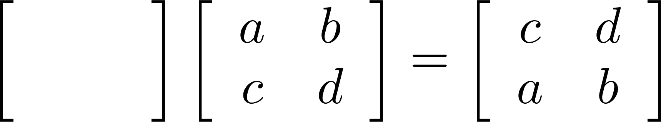
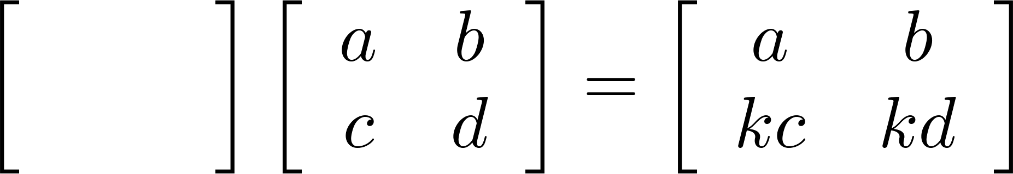
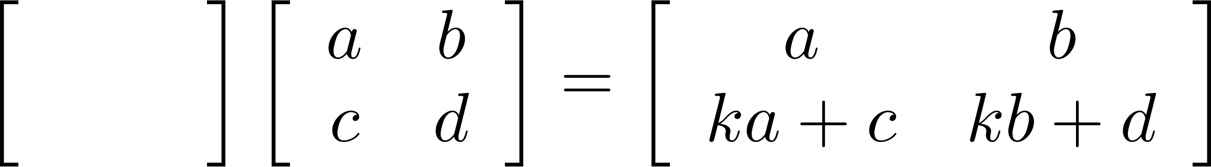
Elementary Row Operation
Every elementary row operation can be performed by matrix multiplication.
1. Interchange
2. Scaling
3. Adding k times row i to row j:
elementary matrix
0
1
1
0
1
0
0
k
1
0
k
1

Slide 18




Elementary Matrix
Every elementary row operation can be performed by matrix multiplication.
How to find elementary matrix?
elementary matrix
E.g. the elementary matrix that exchange the 1st and 2nd rows
$$E\left[\begin{matrix}1 & 4 \\ 2 & 5 \\ 3 & 6\end{matrix}\right]=\left[\begin{matrix}2 & 5 \\ 1 & 4 \\ 3 & 6\end{matrix}\right]$$
$$E\left[\begin{matrix}1 & 0 & 0 \\ 0 & 1 & 0 \\ 0 & 0 & 1\end{matrix}\right]$$
$$\left[\begin{matrix}0 & 1 & 0 \\ 1 & 0 & 0 \\ 0 & 0 & 1\end{matrix}\right]$$
=
$$E=\left[\begin{matrix}0 & 1 & 0 \\ 1 & 0 & 0 \\ 0 & 0 & 1\end{matrix}\right]$$

Slide 19






Elementary Matrix
How to find elementary matrix?
Apply the desired elementary row operation on Identity matrix
$$\left[\begin{matrix}1 & 0 & 0 \\ 0 & 1 & 0 \\ 0 & 0 & 1\end{matrix}\right]$$
$$E_{1}=\left[\begin{matrix}1 & 0 & 0 \\ 0 & 0 & 1 \\ 0 & 1 & 0\end{matrix}\right]$$
Exchange the 2nd and 3rd rows
Multiply the 2nd row by -4
$$\left[\begin{matrix}1 & 0 & 0 \\ 0 & 1 & 0 \\ 0 & 0 & 1\end{matrix}\right]$$
$$E_{2}=\left[\begin{matrix}1 & 0 & 0 \\ 0 & −4 & 0 \\ 0 & 0 & 1\end{matrix}\right]$$
Adding 2 times row 1 to row 3
$$\left[\begin{matrix}1 & 0 & 0 \\ 0 & 1 & 0 \\ 0 & 0 & 1\end{matrix}\right]$$
$$E_{3}=\left[\begin{matrix}1 & 0 & 0 \\ 0 & 1 & 0 \\ 2 & 0 & 1\end{matrix}\right]$$

Slide 20




Elementary Matrix
How to find elementary matrix?
Apply the desired elementary row operation on Identity matrix
$$A=\left[\begin{matrix}1 & 4 \\ 2 & 5 \\ 3 & 6\end{matrix}\right]$$
$$E_{1}A=\left[\begin{matrix}1 & 4 \\ 3 & 6 \\ 2 & 5\end{matrix}\right]$$
$$E_{1}=\left[\begin{matrix}1 & 0 & 0 \\ 0 & 0 & 1 \\ 0 & 1 & 0\end{matrix}\right]$$
$$E_{2}=\left[\begin{matrix}1 & 0 & 0 \\ 0 & −4 & 0 \\ 0 & 0 & 1\end{matrix}\right]$$
$$E_{2}A=\left[\begin{matrix}1 & 4 \\ −8 & −20 \\ 3 & 6\end{matrix}\right]$$
$$E_{3}=\left[\begin{matrix}1 & 0 & 0 \\ 0 & 1 & 0 \\ 2 & 0 & 1\end{matrix}\right]$$
$$E_{3}A=\left[\begin{matrix}1 & 4 \\ 2 & 5 \\ 5 & 14\end{matrix}\right]$$

Slide 21

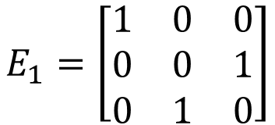

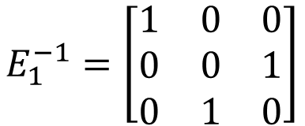


Inverse of Elementary Matrix
Reverse elementary row operation
Exchange the 2nd and 3rd rows
Exchange the 2nd and 3rd rows
$$E_{1}=\left[\begin{matrix}1 & 0 & 0 \\ 0 & 0 & 1 \\ 0 & 1 & 0\end{matrix}\right]$$
$$E_{1}^{−1}=\left[\begin{matrix}1 & 0 & 0 \\ 0 & 0 & 1 \\ 0 & 1 & 0\end{matrix}\right]$$
Multiply the 2nd row by -4
Multiply the 2nd row by -1/4
$$E_{2}=\left[\begin{matrix}1 & 0 & 0 \\ 0 & −4 & 0 \\ 0 & 0 & 1\end{matrix}\right]$$
$$E_{2}^{−1}=\left[\begin{matrix}1 & 0 & 0 \\ 0 & −1/4 & 0 \\ 0 & 0 & 1\end{matrix}\right]$$
Adding 2 times row 1 to row 3
Adding -2 times row 1 to row 3
$$E_{3}=\left[\begin{matrix}1 & 0 & 0 \\ 0 & 1 & 0 \\ 2 & 0 & 1\end{matrix}\right]$$
$$E_{3}^{−1}=\left[\begin{matrix}1 & 0 & 0 \\ 0 & 1 & 0 \\ −2 & 0 & 1\end{matrix}\right]$$
Notes:
The inverse of elementary matrix is another elementary matrix that do the reverse row operation.

Slide 22



RREF v.s. Elementary Matrix
Let A be an mxn matrix with reduced row echelon form R.
There exists an invertible m x m matrix P such that PA=R
$$E_{k}⋯E_{2}E_{1}A=R$$
$$P=E_{k}⋯E_{2}E_{1}$$
$$P^{−1}=E_{1}^{−1}E_{2}^{−1}⋯E_{k}^{−1}$$

Slide 23
Inverse of a Matrix
Invertible
Notes:
Check by Theorem 2.6 (P126 ~ 127)
⬄ (b) Thm 2.5
➔ (e) x = A⁻¹ b. (e)➔(a) Suppose A = PR, where the last row of R is zero. Let b = Pen. Then Ax=b➔Rx=en
(c) ⬄ (f) Nullity = n – rank(A) = n- n = 0. (# of free variables = 0)
(g) ⬄ (c) Thm 1.8 (a)(d)
➔ (h) x = A⁻¹ 0 = 0; (h)➔(a)Suppose some x\neq 0 s.t. Ax=0
(i) ➔ (h) ➔ (a) : Let v be any vector in R^{n} such that Av = 0. Then
v = I_{n} v = (BA)v = B (Av) = B 0 = 0
(j) ➔ (e) ➔ (a): Let b be any vector in Rn and let v = Cb.
Then Av = A(Cb) = (AC) b = In b = b. ➔ (e)
(b) ➔ (k) In = Ek … E2 E1 A ➔ Ek⁻¹ = Ek…E2E1A ➔ A = E1⁻¹ E2⁻¹… Ek⁻¹

Slide 24
Summary
Let A be an n x n matrix. A is invertible if and only if
The columns of A span R^{n}
For every b in R^{n}, the system Ax=b is consistent
The rank of A is n
The columns of A are linear independent
The only solution to Ax=0 is the zero vector
The nullity of A is zero
The reduced row echelon form of A is I_{n}
A is a product of elementary matrices
There exists an n x n matrix B such that BA = I_{n}
There exists an n x n matrix C such that AC = I_{n}
Notes:
When A is square, one side is sufficient.

Slide 25

http://goo.gl/z3J5Rb
Notes:
張三豐使了一次太極劍，張無忌看清楚了，張三豐叫他想想，過了一會兒，張無忌已忘了一大半。 張三豐微笑演示了第二次，但這次和第一次竟沒一招相同，張無忌表示還有三招沒忘，沉思半晌後，滿臉喜色叫道: 這我可全忘了，忘得乾乾淨的。"

Slide 26






Review
Range (值域)
Given a function f
$$v_{1}$$
$$f\left(v_{1}\right)$$
$$v_{2}$$
$$f\left(v_{2}\right)$$
$$=f\left(v_{3}\right)$$
$$v_{3}$$
Domain (定義域)
Co-domain (對應域)
Given a linear function corresponding to a mxn matrix A
Domain=R^{n}
Co-domain=R^{m}
Range=?

Slide 27








One-to-one
A function f is one-to-one
If co-domain is “smaller” than the domain, f cannot be one-to-one.
$$v_{1}$$
$$f\left(v_{1}\right)$$
If a matrix A is 矮胖, it cannot be one-to-one.
$$v_{2}$$
$$f\left(v_{2}\right)$$
$$f\left(v_{3}\right)$$
The reverse is not true.
$$v_{3}$$
If a matrix A is one-to-one, its columns are independent.
$f\left(x\right)=b$ has one solution
$f\left(x\right)=b$ has at most one solution
Notes:
One-to-one：input domain的object和output domain的object有一对一的关系
Smaller：一个萝卜不够一个坑；output的维度比input低，不够了！
函数f可以对应一个矩阵A(m×n)。
output小于input：row数量小于column，矮胖，m < n。将一个向量或者矩阵输入（右乘！！）A(m×n) @ v(n×w) = f(v) (m×w) ，m×w小于n×w
矩阵A将高维矩阵压缩到低维，比如将一个正方体压缩成正方形，此时正方形中一个点对应正方体面积中的很多点，这些点坍缩到一起了，因此无法One-to-one。
one-to-one的时候有唯一解，此时columns are independent.

Slide 28


Onto
A function f is onto
If co-domain is “larger” than the domain, f cannot be onto.
$$v_{1}$$
$$f\left(v_{1}\right)$$
If a matrix A is 高瘦, it cannot be onto.
$$v_{2}$$
$$f\left(v_{2}\right)$$
$$=f\left(v_{3}\right)$$
The reverse is not true.
$$v_{3}$$
If a matrix A is onto,
rank A = no. of rows.
Co-domain = range
$f\left(x\right)=b$ always have solution
Notes:
所有input的domain每一个object的mapping可以span所有的output的co-domain
Larger：坑太多了，萝卜不够放了；低维的怎么也没法占满高维的空间
函数f可以对应一个矩阵A(m×n)。
Output大于input：row数量大于column，高瘦，m > n。将一个向量或者矩阵输入（右乘！！）A(m×n) @ v(n×w) = f(v) (m×w) ，m×w大于n×w。
矩阵A将低维矩阵map到高维，比如将一个正方形拉伸成正方形，低维的怎么也没法占满高维的空间，有冗杂，所以坑不够放萝卜。
rank A = no. of rows：意味着信息（方程）足够解

Slide 29










Invertible
An invertible matrix A is always square.
A is called invertible if there is a matrix B such that $AB=I$ and $BA=I$ ($B=A^{−1}$)
$$A$$
$$A$$
$$Av$$
$$A^{−1}v$$
$$v$$
$$v$$
$$A^{−1}$$
$$A^{−1}$$
A must be one-to-one
A must be onto
(不然 $A^{−1}$ 的 input 就會有限制)
Notes:
One-to-one：可以还原
So here, "singular" is not being taken in the sense of "single", but rather in the sense of "special", "not common". See the dictionary definition: it includes "odd", "exceptional", "unusual", "peculiar".
http://math.stackexchange.com/questions/42649/why-are-invertible-matrices-called-non-singular

Slide 30






One-to-one and onto
A function f is one-to-one and onto
$$v_{1}$$
The domain and co-domain must have “the same size”.
$$f\left(v_{1}\right)$$
$$v_{2}$$
$$f\left(v_{2}\right)$$
The corresponding matrix A is square.
$$v_{3}$$
$$f\left(v_{3}\right)$$
One-to-one
Onto
在滿足 Square 的前提下，要就都成立，要就都不成立
Notes:
one-to-one：“一个萝卜一个坑”
onto：“所有的坑都被放满了”
“萝卜和坑的数量一样多”

Slide 31
Invertible
Let A be an n x n matrix.
Onto → One-to-one → invertible
The columns of A span R^{n}
For every b in R^{n}, the system Ax=b is consistent
The rank of A is the number of rows
One-to-one → Onto → invertible
The columns of A are linear independent
The rank of A is the number of columns
The nullity of A is zero
The only solution to Ax=0 is the zero vector
The reduced row echelon form of A is I_{n}
Rank A = n

Slide 32

Invertible
Let A be an n x n matrix. A is invertible if and only if
The reduced row echelon form of A is I_{n}
I_{n}
RREF
Invertible
RREF
Not Invertible

Slide 33
Summary
Let A be an n x n matrix. A is invertible if and only if
The columns of A span R^{n}
For every b in R^{n}, the system Ax=b is consistent
The rank of A is n
The columns of A are linear independent
The only solution to Ax=0 is the zero vector
The nullity of A is zero
The reduced row echelon form of A is I_{n}
A is a product of elementary matrices
There exists an n x n matrix B such that BA = I_{n}
There exists an n x n matrix C such that AC = I_{n}
onto
square matrix
=
One-to-one
Notes:
When A is square, one side is sufficient.

Slide 34



Invertible
An n x n matrix A is invertible.
R=RREF(A)=I_{n}
$$E_{k}⋯E_{2}E_{1}A=I_{n}$$
The reduced row echelon form of A is I_{n}
$$A=E_{1}^{−1}E_{2}^{−1}⋯E_{k}^{−1}I_{n}$$
$$=E_{1}^{−1}E_{2}^{−1}⋯E_{k}^{−1}$$
A is a product of elementary matrices

Slide 35





Invertible
An n x n matrix A is invertible.
There exists an n x n matrix B such that BA = I_{n}
?
The only solution to Ax=0 is the zero vector
If $Av=0$, then ….
$$BA=I_{n}$$
$$v=0$$
$$BAv=0$$
$$I_{n}v=v$$

Slide 36




Invertible
An n x n matrix A is invertible.
There exists an n x n matrix C such that AC = I_{n}
?
For every b in R^{n}, Ax=b is consistent
For any vector b,
$$AC=I_{n}$$
$Cb$ is always a solution for $b$
$$ACb$$
$$I_{n}b=b$$
Notes:
Another way
E1 is linear combination
E2
…
en

Slide 37
Summary
Let A be an n x n matrix. A is invertible if and only if
The columns of A span R^{n}
For every b in R^{n}, the system Ax=b is consistent
The rank of A is n
The columns of A are linear independent
The only solution to Ax=0 is the zero vector
The nullity of A is zero
The reduced row echelon form of A is I_{n}
A is a product of elementary matrices
There exists an n x n matrix B such that BA = I_{n}
There exists an n x n matrix C such that AC = I_{n}
onto
square matrix
=
One-to-one
Notes:
When A is square, one side is sufficient.

Slide 38
Questions
If A and B are matrices such that AB=I_{n} for some n, then both A and B are invertible.
For any two n by n matrices A and B, if AB=I_{n}, then both A and B are invertible.
Notes:
F
T

Slide 39
Inverse of a Matrix
Inverse of
General invertible matrices
Notes:
Outline:
Inverse
Invertibility
elementary row operation
in generatl

Slide 40






2 X 2 Matrix
$$A=\left[\begin{matrix}a & b \\ c & d\end{matrix}\right]$$
$$A^{−1}=\left[\begin{matrix}e & f \\ g & h\end{matrix}\right]$$
Find $e,f,g,h$
$$\left[\begin{matrix}a & b \\ c & d\end{matrix}\right]\left[\begin{matrix}e & f \\ g & h\end{matrix}\right]=\left[\begin{matrix}1 & 0 \\ 0 & 1\end{matrix}\right]$$
$$A^{−1}=\frac{1}{ad−bc}\left[\begin{matrix}d & −b \\ −c & a\end{matrix}\right]$$
If $ad−bc=0$, A is not invertible.

Slide 41




Algorithm for Matrix Inversion
Let A be an n x n matrix. A is invertible if and only if
The reduced row echelon form of A is I_{n}
$$E_{k}⋯E_{2}E_{1}A=R$$
$$=I_{n}$$
$$A^{−1}$$
$$A^{−1}=E_{k}⋯E_{2}E_{1}$$

Slide 42




Algorithm for Matrix Inversion
Let A be an n x n matrix. Transform [ A I_{n} ] into its RREF [ R B ]
R is the RREF of A
B is an nxn matrix (not RREF)
If R = I_{n}, then A is invertible
B = A⁻¹
$$E_{k}⋯E_{2}E_{1}\left[\begin{matrix}A & I_{n}\end{matrix}\right]$$
$$=\left[\begin{matrix}R & E_{k}⋯E_{2}E_{1}\end{matrix}\right]$$
$$I_{n}$$
$$A^{−1}$$

Slide 43

Algorithm for Matrix Inversion
I_{n}
Invertible
RREF

Slide 44





Algorithm for Matrix Inversion
Let A be an n x n matrix. Transform [ A I_{n} ] into its RREF [ R B ]
R is the RREF of A
B is a nxn matrix (not RREF)
If R = I_{n}, then A is invertible
B = A⁻¹
To find A⁻¹C, transform [ A C ] into its RREF [ R C’ ]
C’ = A⁻¹C
$$A^{−1}C$$
$$E_{k}⋯E_{2}E_{1}\left[\begin{matrix}A & C\end{matrix}\right]$$
$$=\left[\begin{matrix}R & E_{k}⋯E_{2}E_{1}C\end{matrix}\right]$$
$$I_{n}$$
$$A^{−1}$$
P139 - 140

Slide 45
Appendix

Slide 46









2 X 2 Matrix
$$A=\left[\begin{matrix}a & b \\ c & d\end{matrix}\right]$$
$$\left[\begin{matrix}a \\ c\end{matrix}\right]≠k\left[\begin{matrix}b \\ d\end{matrix}\right]$$
$$\frac{a}{b}≠\frac{c}{d}$$
$$ad≠bc$$
$$ad−bc≠0$$
$$A^{−1}=\left[\begin{matrix}e & f \\ g & f\end{matrix}\right]$$
Find $e,f,g,h$
$$\left[\begin{matrix}a & b \\ c & d\end{matrix}\right]\left[\begin{matrix}e & f \\ g & f\end{matrix}\right]=\left[\begin{matrix}1 & 0 \\ 0 & 1\end{matrix}\right]$$
$$A^{−1}=\frac{1}{ad−bc}\left[\begin{matrix}d & −b \\ −c & a\end{matrix}\right]$$

